Slide 1

DEEP LEARNING FOR AUDIO SUPER RESOLUTION
Giorgio Bini, 838674
University of Milano-Bicocca
Advisor: Prof. Simone Bianco
Co-advisor: Dr. Marco Buzzelli
Academic Year 2019-2020

Slide 2
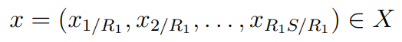
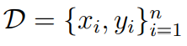
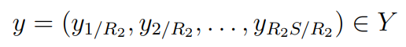
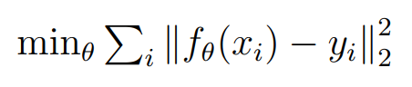
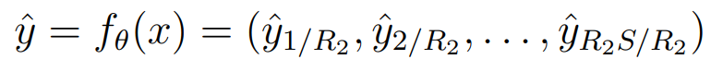

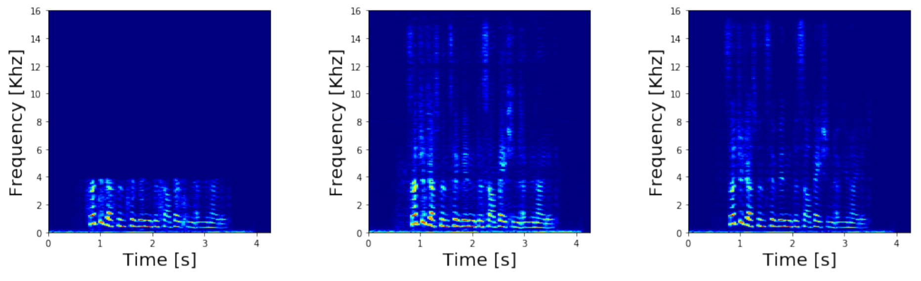
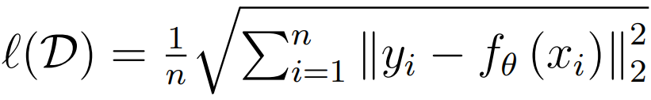
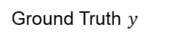
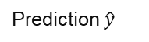
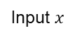
Problem Formulation
A supervised learning approach
Audio Super Resolution model can be seen as a mapping function ${ f}_{θ}\text{: }X→Y$
This naturally leads to
Train on:
;
Least-squares optimization
Predict:
MSE objective
Input $x$
Prediction $\hat{y}$
Ground Truth $y$
In our setting: $R_{2}$ = 16 kHz, r = $\frac{R_{2}}{R_{1}}=4.$

Slide 3

2 main references
Authors propose a model which utilizes both time and frequency domain, in two different branches.
1
TFNet [1]
The main idea is to combine the two methods.
2
TFiLM Net [2]
It introduces an innovative neural network component that uses a RNN to alter activations of convolutional layers.
[1]
Teck Yian Lim et al. “Time-frequency networks for audio super-resolution”. In: 2018 IEEE International Conference on Acoustics, Speech and Signal Processing (ICASSP). IEEE. 2018
[2]
Sawyer Birnbaum et al. ”Temporal FiLM: Capturing Long-Range Sequence Dependencies with Feature-Wise Modulations.” In: Advances in Neural Information Processing Systems. 2019

Slide 4
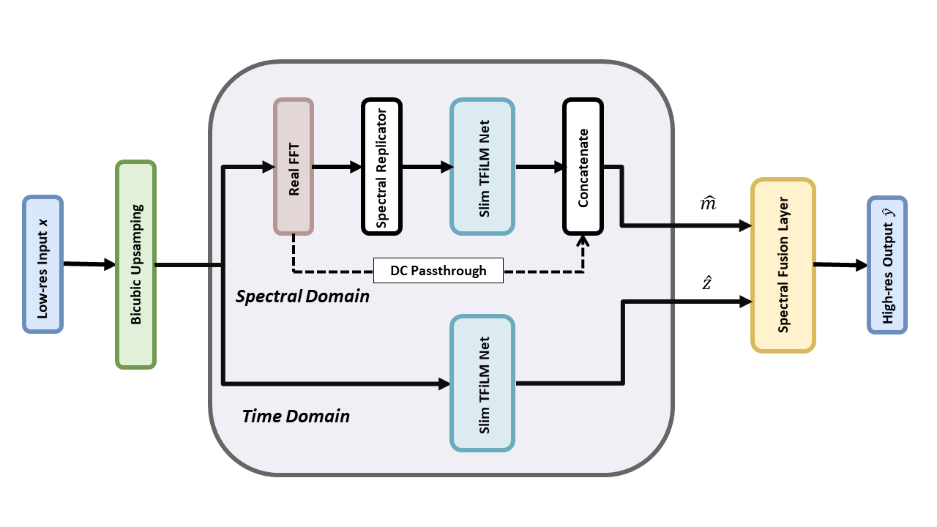
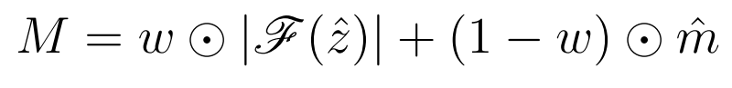
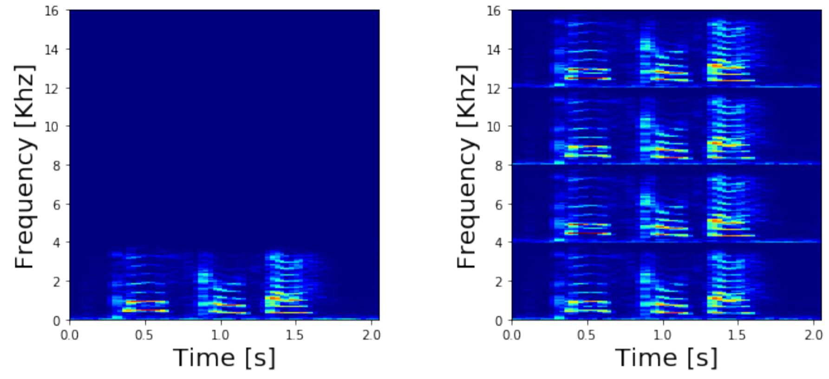
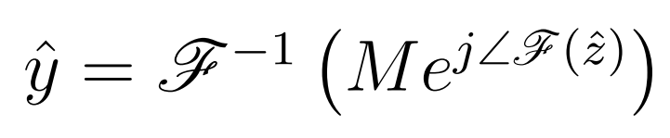
Proposed Approach
Spectral Fusion Layer
Network overview
Spectral Replicator
It permits to combine outputs of the two branches. Phase is estimated only in the time domain.
The low-frequency components of the input spectrum are replicated three times in order to replace zeros in the high-frequency counterpart.
Spectral magnitude estimate
Final output estimate
Input
Output

Slide 5
Experimental setup
Papers overview
Dataset
Size
VCTK Corpus: 44 hours of speech data uttered by 109 English speakers
Approx. 35M parameters
Experimental setup of the papers
Sampling procedure with gender stratification
Dimensionality reduction
40 speakers
Approx. 22M parameters

Slide 6
Experimental setup
Data preparation
16 kHz – 16 bit – single channel
Step 01 Obtaining the low-resolution version (signal downsampling)
Step 03 Extracting 8192 samples length (500ms) subsequences with 75% overlap
01
03
02
04
Step 02 Filtering “silence sequences” from the training set
Step 04 Cubic B-spline interpolation

Slide 7
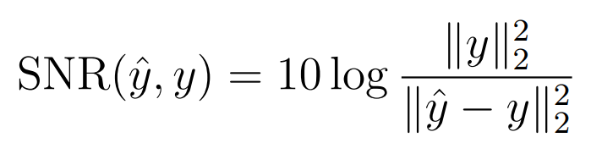
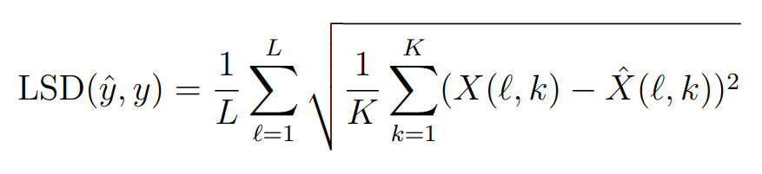
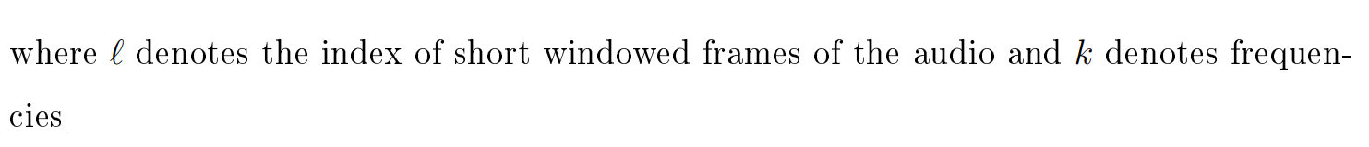
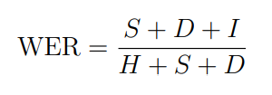
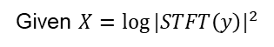
Experimental setup
Evaluation metrics
Given a reference signal $\text{y}$ and an approximation $\hat{y}$:
Signal to Noise Ratio
It measures the reconstruction quality in the time domain
Given $X={log⁡|STFT\left(y\right)|}^{2}$
It measures the reconstruction quality in the frequency domain
Log Spectral Distance
Given the total number of word hits, substitutions, deletions and insertions:
Speech To Text engine: Deep Speech
Word Error Rate [3]
[3]
Awni Hannun et al. Deep speech: Scaling up end-to-end speech recognition. In:
arXiv preprint arXiv:1412.5567 (2014)

Slide 8
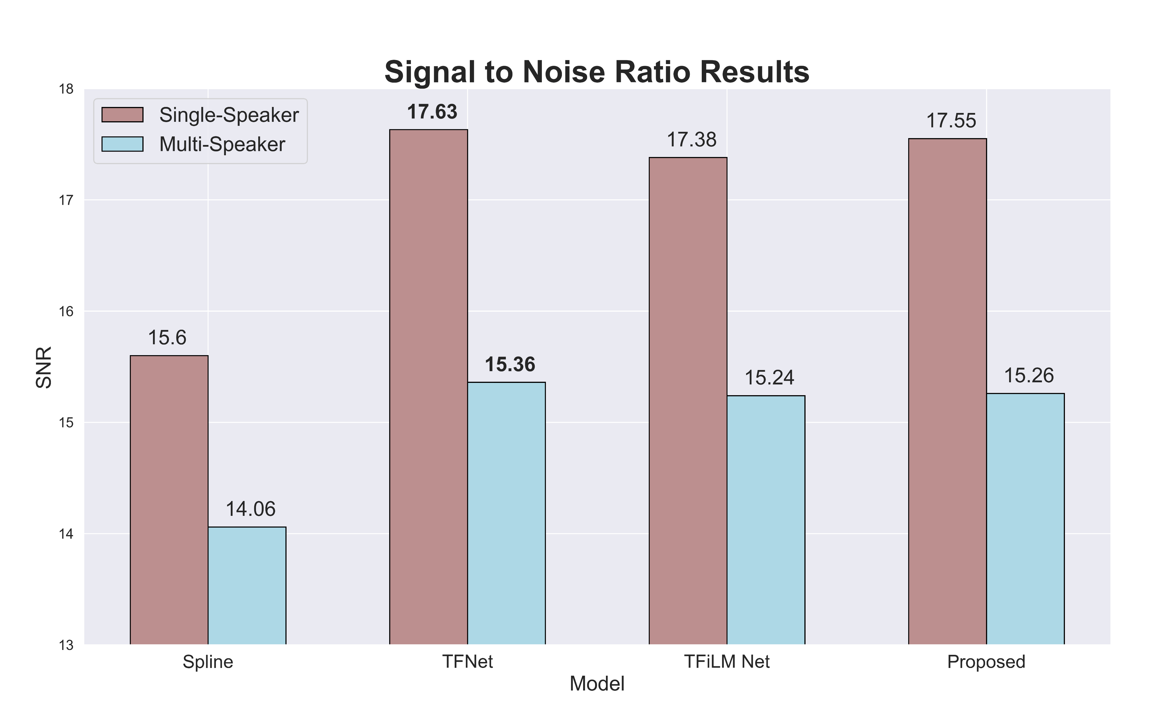

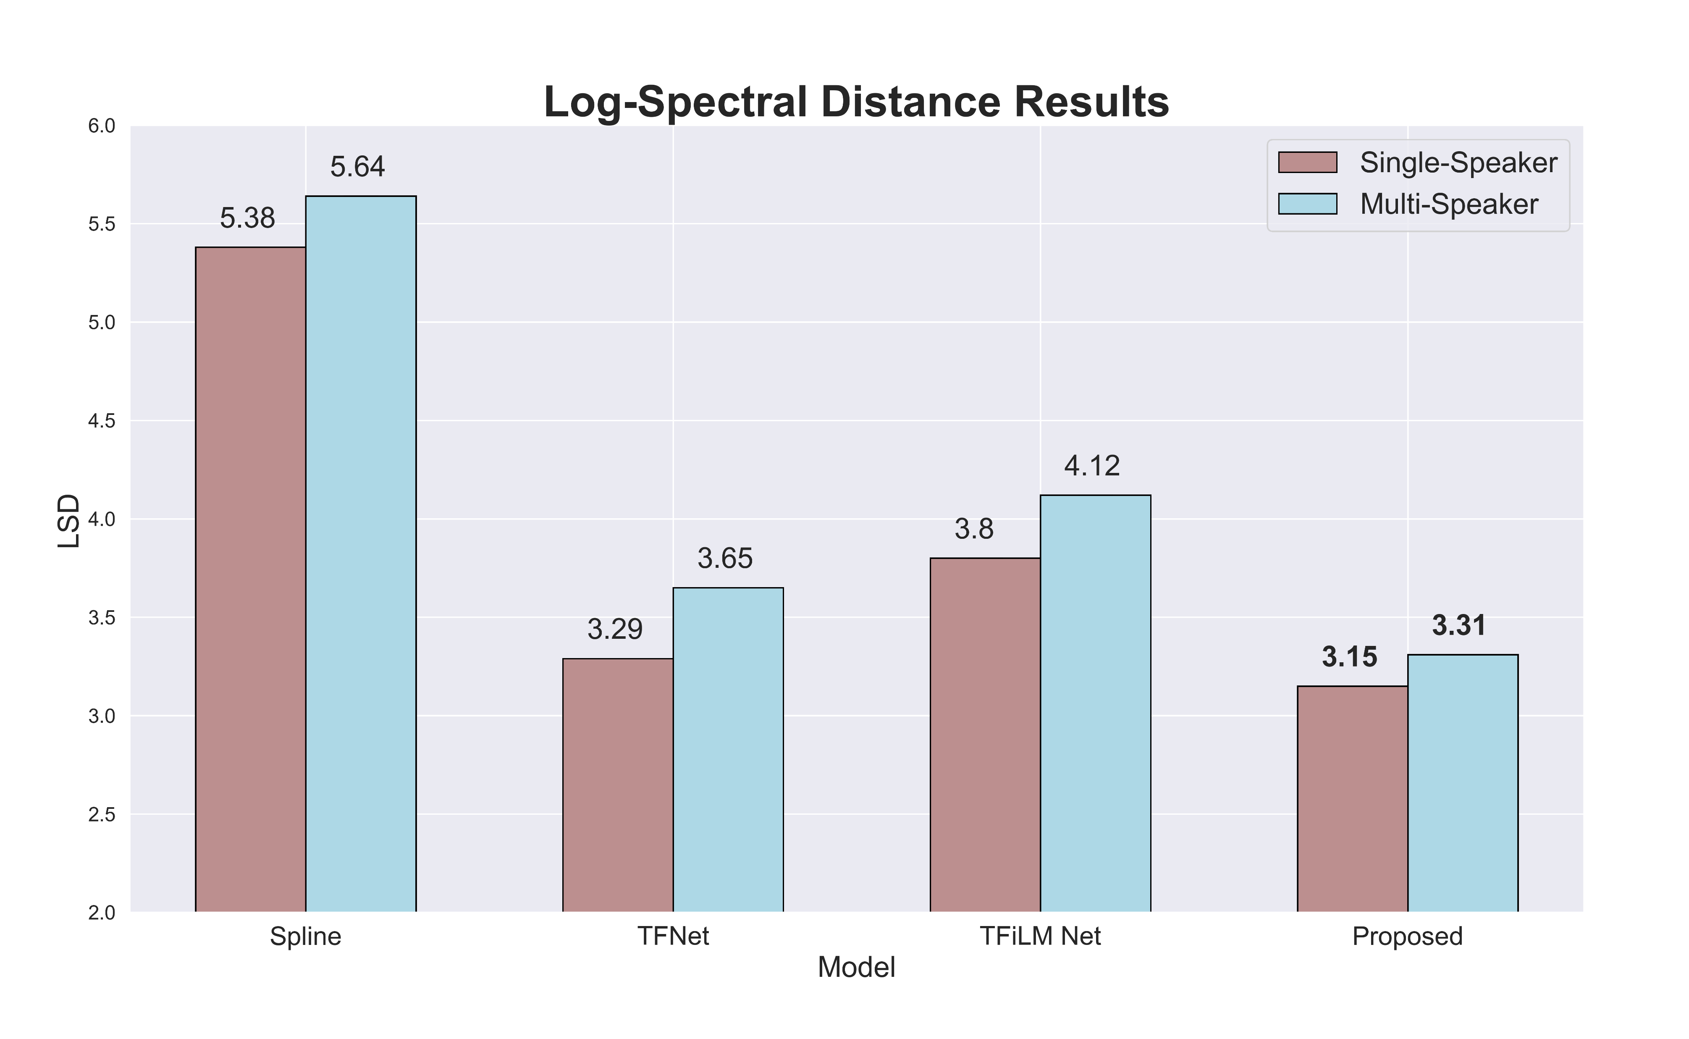
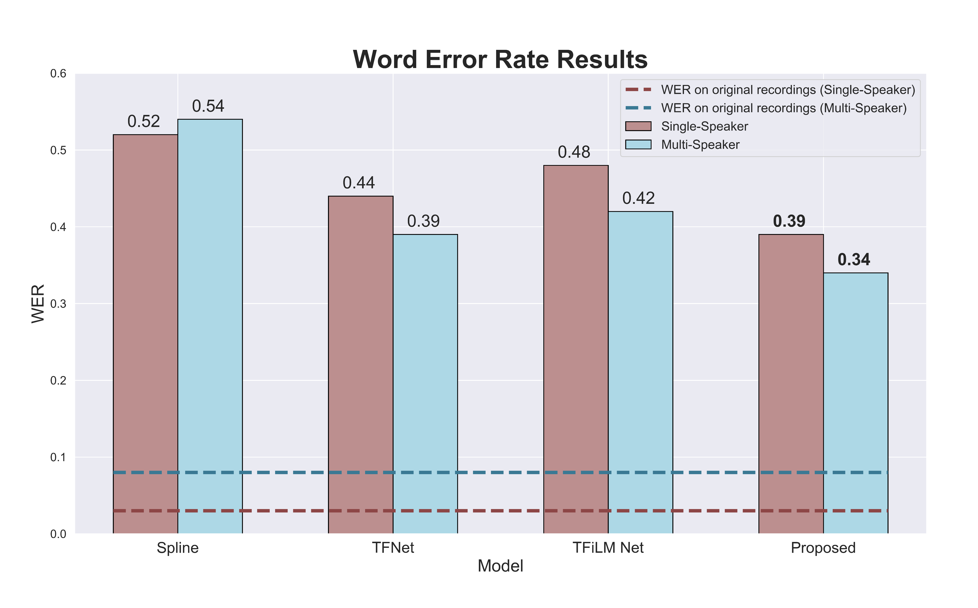
Results
SNR
Single-speaker
2 different tasks
LSD
Multi-speaker
WER

Slide 9


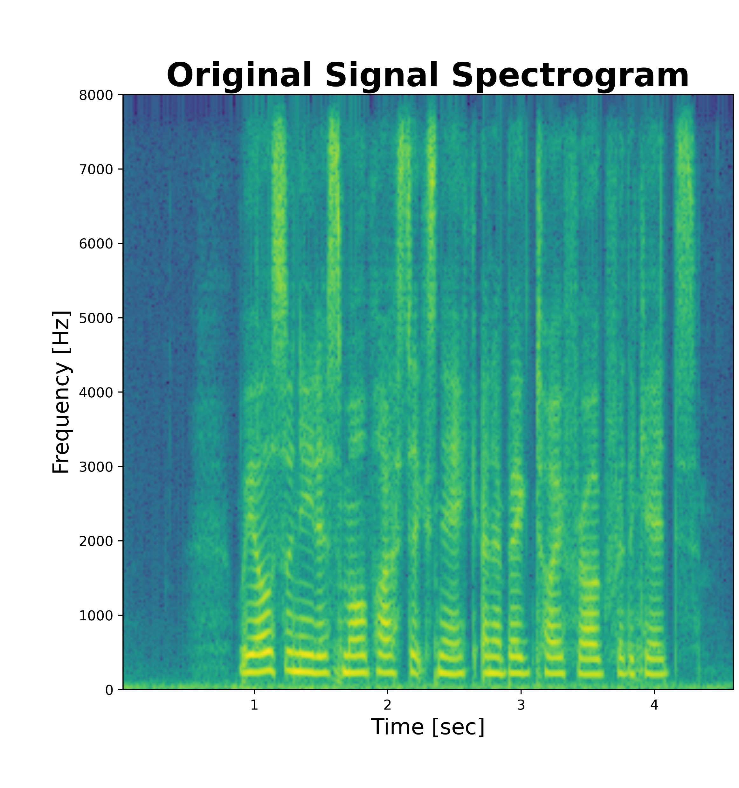
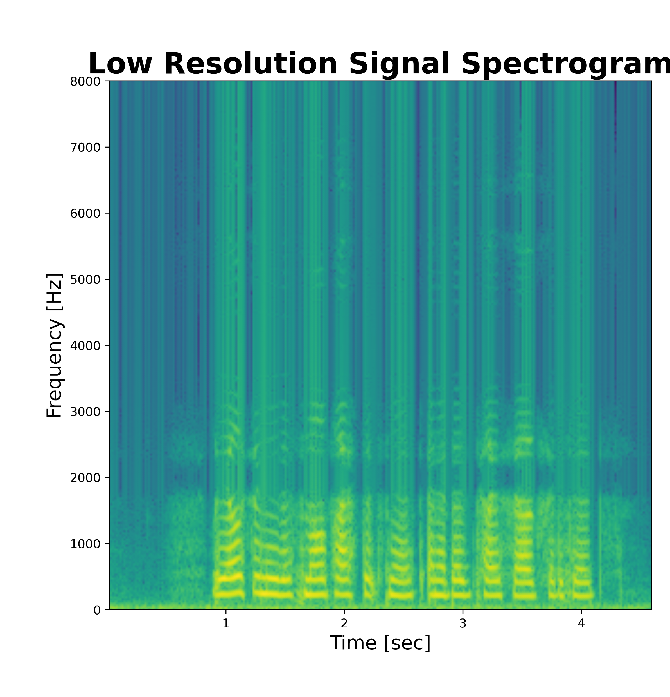
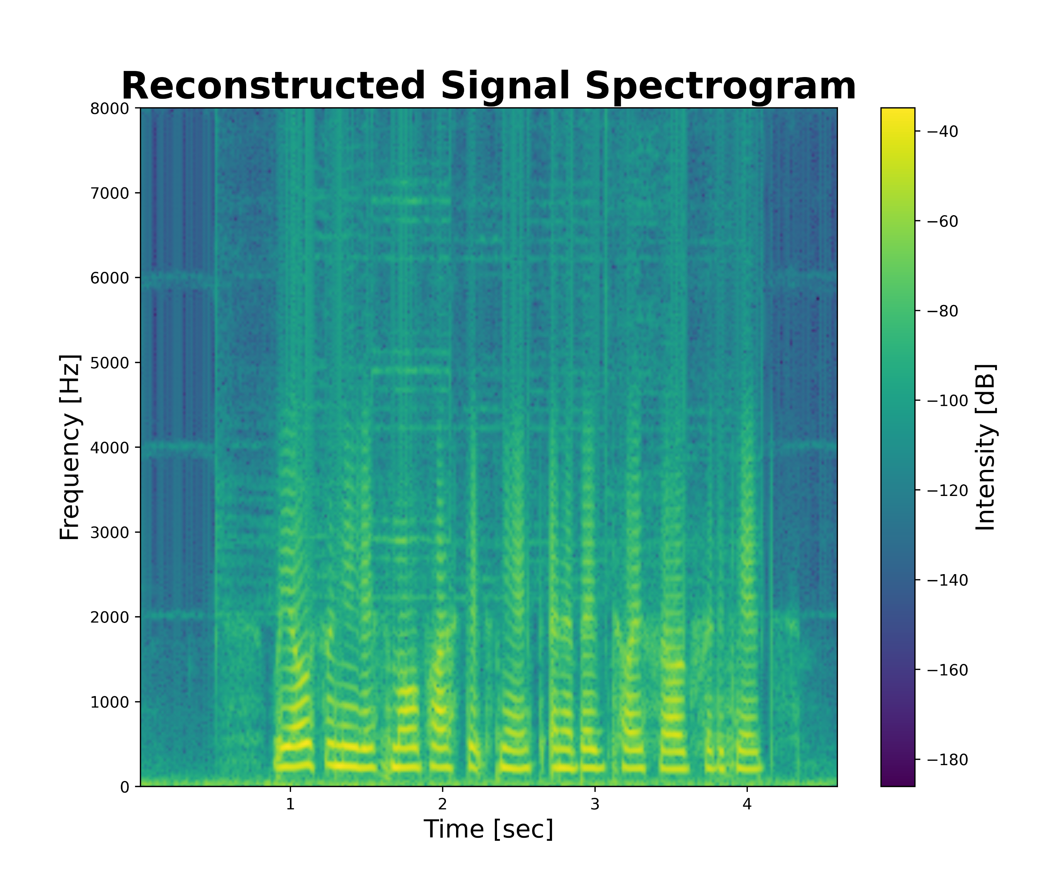
Demo
We also need a small plastic snake and a big toy frog for the kids.
Deep Speech conversion
We also need a small plastic neck and a big toy frog for the gates.
Without the monosyllabic and besieged.
We also need a small plastic parties and a bed too for the man.

Slide 10

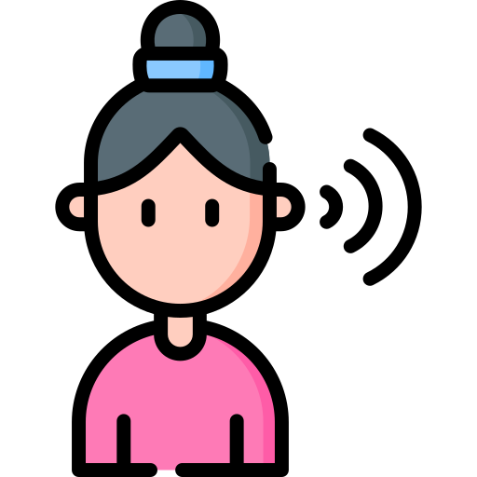


Conclusions
The proposed model achieved remarkable results
Further Work
Include qualitative metrics based on human perception of audio quality
Use the whole dataset
Evaluate our model without a drastic dimensionality reduction of the models' number of parameters

Slide 11
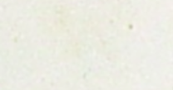
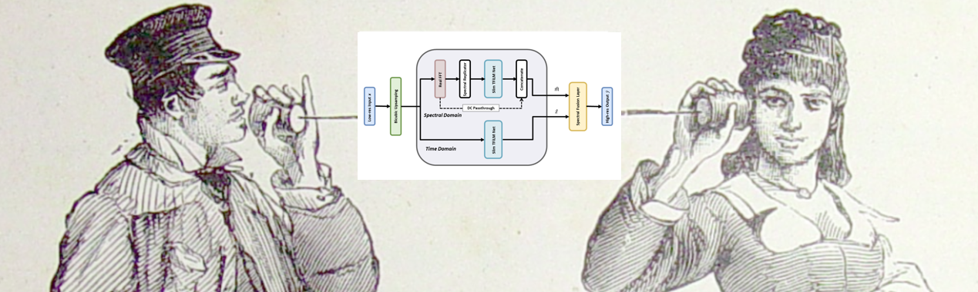
THANK YOU !

Slide 12

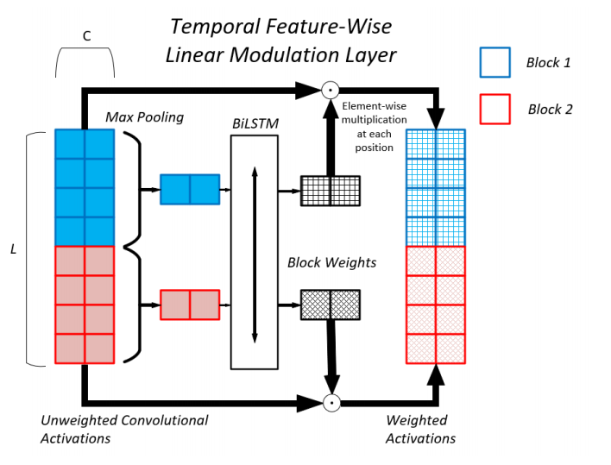
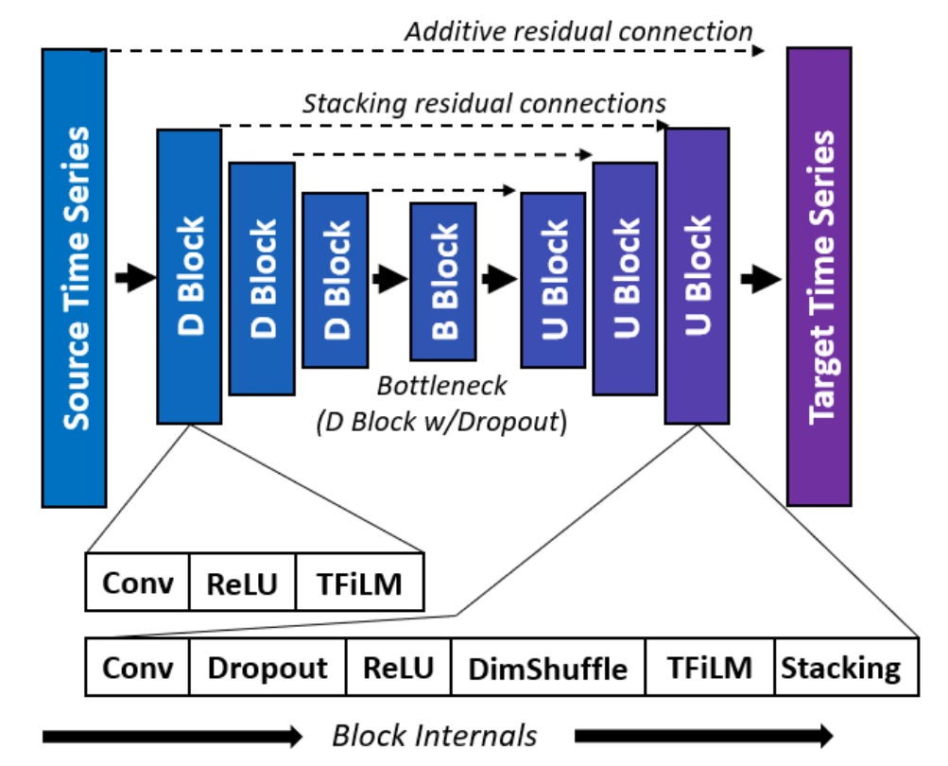
Slim TFiLM Net: a time series super-resolution architecture
In our setting:
3 upsampling and 3 downsampling blocks
Unidirectional LSTM

Slide 13


Slide 16
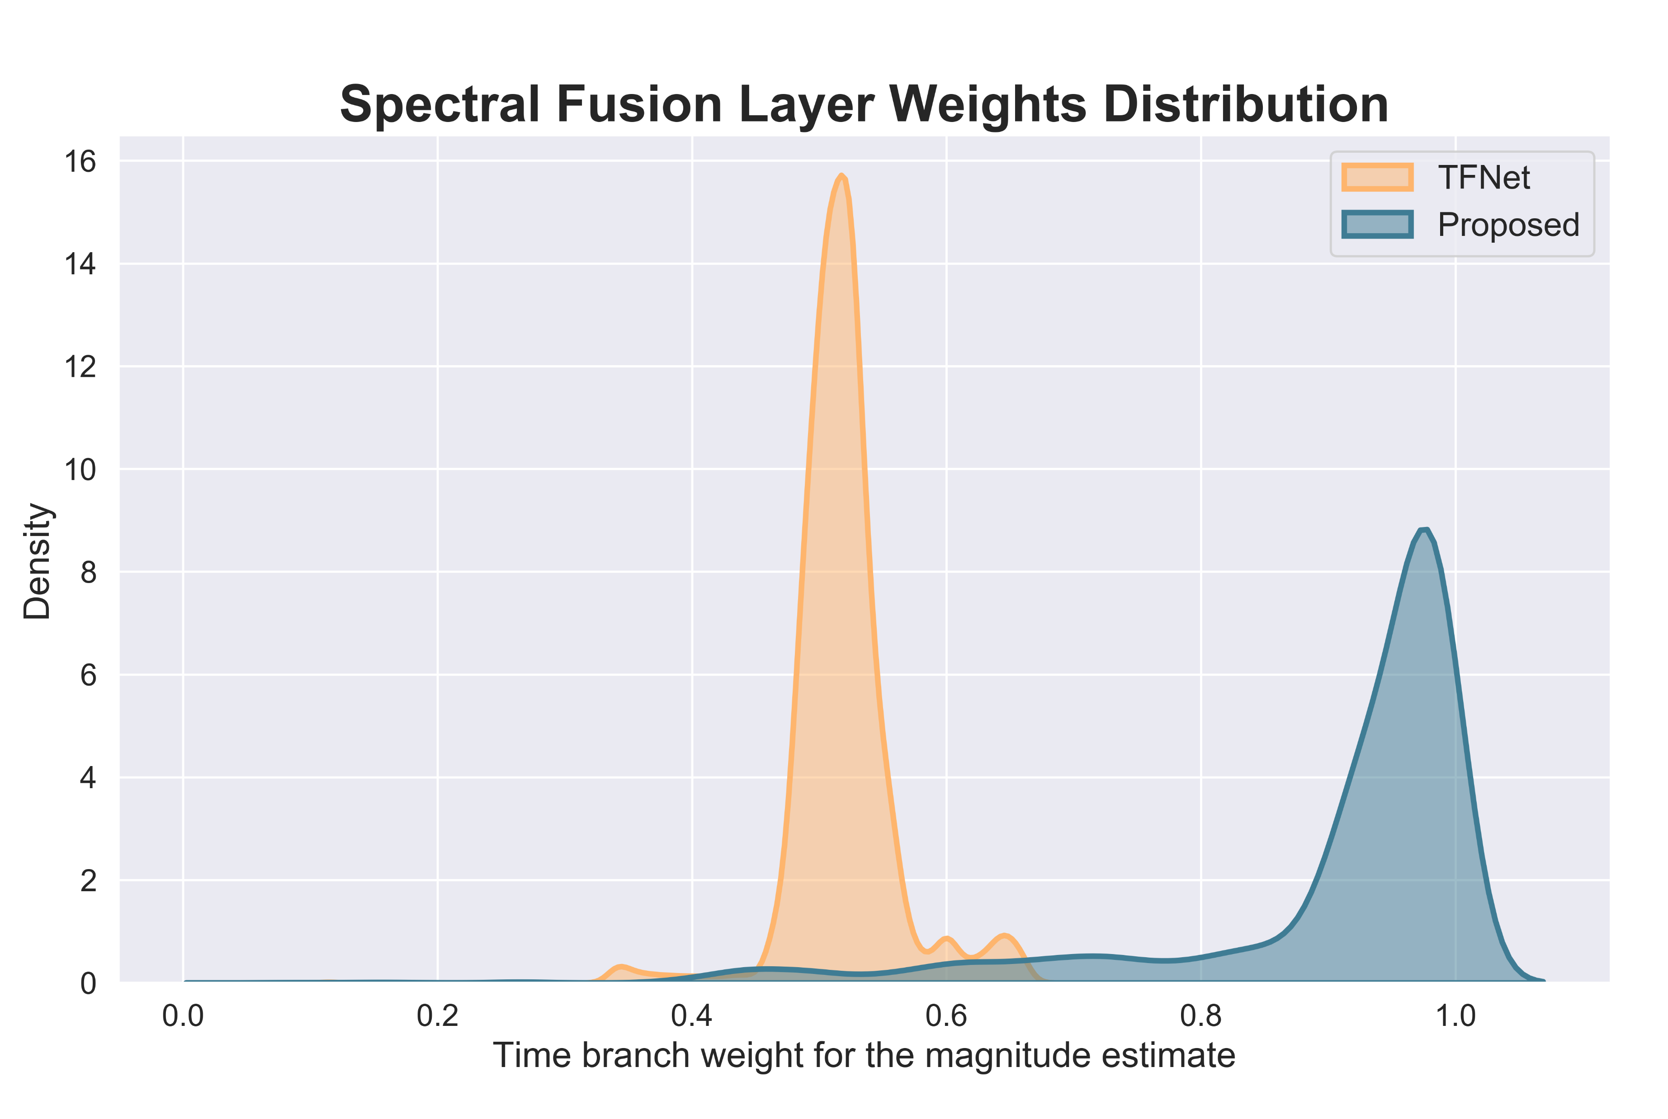
Spectral Fusion Layer Weights Analysis

Slide 17
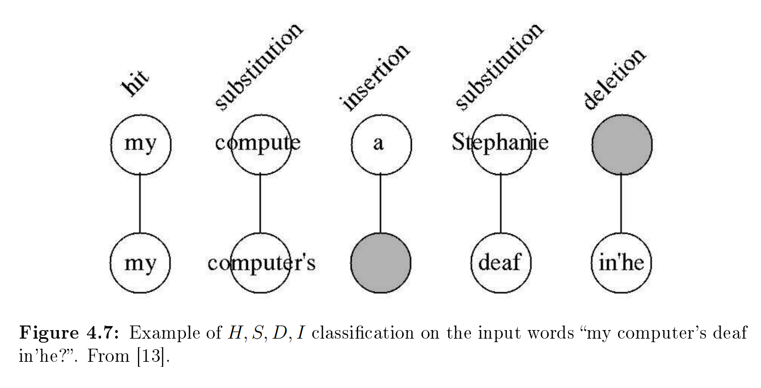
Word Error Rate

